Slide 1
Course Introduction
Welcome to ENGL 3110

Slide 2
Unit Two
Sentence Patterns, Adverbials, and Conjunctions
  Identify Six Sentence Patterns
  Name the parts of the Sentence Patterns
  Identify Optional Adverbials (ADVP and PP only)
  Identify and Diagram Conjunctions and what they connect
  Diagram the Six Sentence Patterns and Optional Adverbials

Slide 3
Key Learning Concepts – Unit Two
Six Sentence Patterns
  Intransitive Sentences – What we already know!
  “Copular Be” Verbs with a Subject Complement
  Linking Verbs with a Subject Complement
  Transitive Verbs with a Direct Object
  Ditransitive Verbs with a Direct Object and Indirect Object
  Ditransitive Verbs with a Direct Object and Object Complement
Adverbials
Conjunctions & Clauses (Next Wed)

Slide 4
Key Learning Concepts – Unit Two
Reminder
  Noun Phrases can be replaced by Pronouns
  So… all Objects and Complements can be pronouns too.

Slide 5
Refresher
Shifty Language
  Different linguists and teachers will use words in different ways
  Example: Transitive
    Some people will mean “anything with three arguments”
      All the sentence patterns except “intransitive”
    Some people will mean “anything with a direct object”
  We will use “Transitive” to mean: Mono-transitive
    A verb with a Direct Object but no Indirect Object or Object Complement

Slide 6
Refresher
Shifty Language
  Different linguists and teachers will use words in different ways
  Example: Linking Verb
    Some people will include “be” verbs
    Others will include auxiliaries and even modal auxiliaries.
  We will use “Linking Verb” to include verbs that have a subject complement but will not include “be” verbs or auxiliary verbs.

Slide 7
Refresher
Why so much shiftiness in terms?
  The language itself comes first (descriptive)
  The terms come second (prescriptive and analysis)
    We try to name and describe what we see in the language.
    But we always run into exceptions and weirdness.
  The terms are there to either teach or to analyze
    Less terms means easier teaching but also more exceptions
    More terms means better analysis but also more terms to learn

Slide 8
Refresher
How we will use terms
  Intransitive (what we know now - no “argument” after the verb
  “Copular Be” – a “Be” verb with a Subject Complement
  Linking Verb – a Lining verb with a Subject Complement
  Transitive – a Verb with a Direct Object
  Ditransitive – a Verb with a Direct Object and either…
      An Indirect Object
      An Object Complement

Slide 9
Good Steps to ID Sentence Patterns
Identify the Subject and Verb
Assume it is “Intransitive” to Start and look for evidence that it is not
Look for “Be” verbs first.
  Must be Copular “be”
  Later we will see “be” verbs serve as Auxiliary Verbs that come before the main verb, but we won’t include any of these on the Unit Two materials.
Is it a Linking Verb?
  Try replacing the verb with a “be” verb and see how it changes the meaning. Linking Verbs can usually be replaced by a “be” verb.
Is there an NP after the VP? If so, what is it doing?
  Is it inside a Prepositional Phrase? (Look for a preposition before it)
  If it is NOT inside a prepositional phrase, you likely have a DO – a “Transitive” Sentence
Is there something near that NP? Could it be an Indirect Object or an Object Complement?
  If yes, you may have a “Ditransitive” Sentence.

Slide 10
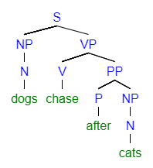
Intransitive Sentence

Slide 11
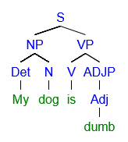
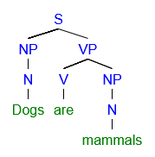
“Copular Be”
  Subject Complement
  is an ADJP
  Subject Complement
  is an NP

Slide 12
“Copular Be”
Start memorizing the forms of “Be”
  Am, Is, Are, Was, Were, Be, Being, Been, To Be
In Unit Two, we will mostly use “Am, Is, Are, Was, Were”
  I will try to save “Be, Being, Been” for Unit Three when we study verb phrases and “To Be” for Unit Four
  Subject Complement
  is an ADJP

Slide 13
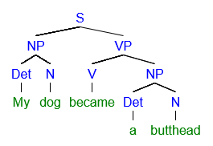
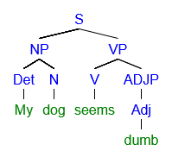
“Linking Verb”
  Subject Complement
  is an ADJP
  Subject Complement
  is a NP

Slide 14
“Linking Verb”
Linking Verbs can usually keep the same meaning if you replace them with a “be” verb.
Some verbs can be both linking verbs or transitive verbs depending on context.
  My dog smells bad = Linking Verb
  My dog smells a cat = Transitive w Direct Object
Don’t Confuse “Linking Verbs” with “Helping Verbs” which is a layman term for “Auxiliary Verbs” which we will study in Unit Three

Slide 15
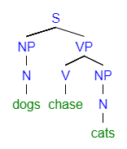
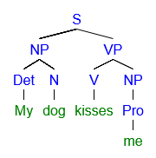
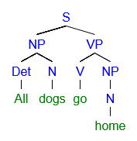
Transitive Verbs
Transitive Verbs

Slide 16
Transitive Sentences
Don’t Confuse a Direct Object with a Prepositional Phrase
Transitive Sentence with Direct Object
Intransitive Sentence with Prepositional Phrase

Slide 17
Transitive Sentences
Don’t Confuse a Direct Object with a Prepositional Phrase
Transitive Sentence with Direct Object
Intransitive Sentence with Prepositional Phrase

Slide 18
Key Learning Concepts – Unit Two
Six Sentence Patterns
  Intransitive Sentences – What we already know!
  “Copular Be” Verbs with a Subject Complement
  Linking Verbs with a Subject Complement
  Transitive Verbs with a Direct Object
  Ditransitive Verbs with a Direct Object and Indirect Object
  Ditransitive Verbs with a Direct Object and Object Complement
“Optional” Adverbials
Conjunctions & Clauses (Next Wed)

Slide 19
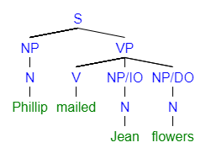
Ditransitive with Direct Object and Indirect Object
Indirect Objects always come BEFORE Direct Objects

Slide 20
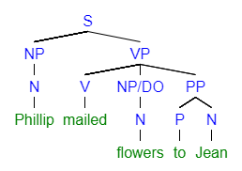
Ditransitive with Direct Object and Indirect Object
Also can be confused with Prepositional Phrases
  Transitive with Direct Object and Prepositional Phrase
Ditransitive with a Direct Object and Indirect Object

Slide 21
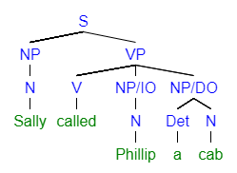
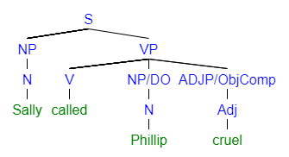
Indirect Objects, Object Complements, and Optional Phrases
Object Complements always come AFTER Direct Objects
  Ditransitive with DO + IO Ditransitive with Object Complement

Slide 22
Ditransitive with a Direct Object and Object Complement
Object Complements always come AFTER Direct Objects

Slide 23
Ditransitive with a Direct Object and Object Complement
Easy to mistake Indirect Objects and Object Complements (Use meaning and order)
  Ditransitive with DO + IO Ditransitive with Object Complement

Slide 24
Adverbials
Have Seen These Already
  All Adverbs
  Some Prepositional Phrases
New Today
  “Sentence” Adverbials = Adverbials modifying the whole sentence
  Diagram them off the S because they modify the whole S
For Exam Two
  Only some PPs and ADVPs (will learn other adverbials later)

Slide 25
Homework RE-view
Open your homework
  I will open the answer key on my computer
We will walk through the homework together
  I will start by asking for students to volunteer answers.
  Once I know you better, I may call on individuals
    If you ever feel uncomfortable, just say “Ugh… Pass”
Feel free to correct your own answers as you go
  There is no need to resubmit your homework.
You can always stop me and ask for more clarification about a question!
  I am happy to diagram a sentence if you feel it would be helpful.

Slide 26
Rest of Class
Take Questions
Add “Roles” to the Homework Tables
Create Sentences to Match Diagrams on White Board
Reminder about Bonus for Friday

Slide 27
“Roles”
SUB = Subject (NPs in Unit 2)
PRED = Predicate (Always a VP)
ADVL = Adverbial (ADVPs or PPs in Unit 2)
DO = Direct Object (NPs in Unit 2)
IO = Indirect Object (NPs in Unit 2)
SC = Subject Complement (NPs, ADJPs, or PPs in Unit 2)
OC = Object Complement (NPs, ADJPs, or PPs in Unit 2)

Slide 28
End of Class
If you have questions or concerns, hang around to talk.

